Slide 1
Let’s Feel Romania... Domain: Tourism Management System

Slide 2
Info
What is Tourism Management ?
It involves the management of multitude of activities such as studying tour destination, planning the tour, making travel arrangements and providing accommodation. It also involves marketing efforts to attract tourists to travel to particular destinations.
In Tourism we have four types
Sustainable tourism
Food tourism
Experiential tourism
Wellness tourism

Slide 3
Client Information
Client Name: Tripaldo
Tripaldo is a destination management company(DMC).
In the future we will improve our investments in technology and education as we share daily with our staff the importance to know Romania tourism offer and our to implement it through technology.

Slide 4
Project business need
Customer wants to globalize his Business
Customer wants to make his business convenient
Customer can run their business 24*7
Easier to handle their end-users
Easy to receive feedback from end-users
Visual presentation of places via Images and videos

Slide 5
Project Architecture
Admin
Tour Package
Manage users
Manage Booking
Manage Issues
Manage Enquiries
Manage Pages
Create
Manage

Slide 6
Project Architecture
Customer
SignUp/SignIn
Home
Home
My Profile
About
About
Change Password
Tour Packages
Tour Packages
My Tour History
Privacy Policy
Privacy Policy
Issue Tickets
Terms of Use
Terms of Use
Contact Us
Contact Us
Enquiry
Need Help? / Write Us

Slide 7
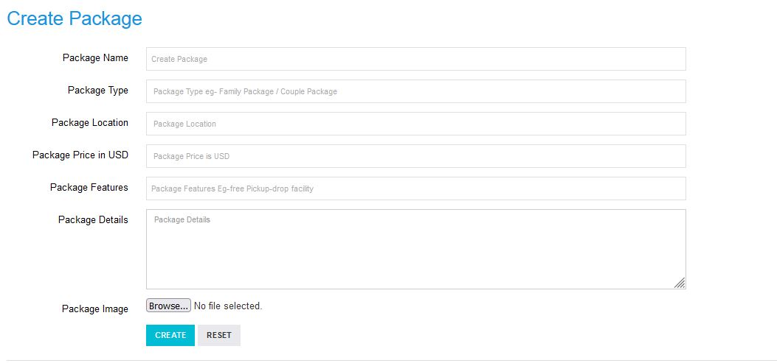
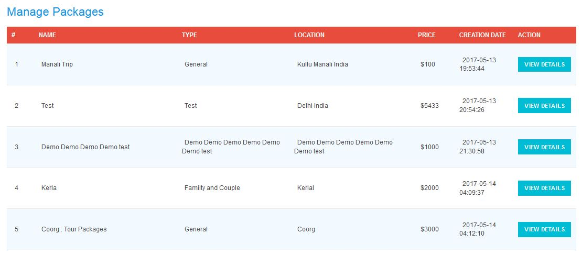
Project Modules
Explanation: Admin Module
Tour Packages:
Create
Manage

Slide 8
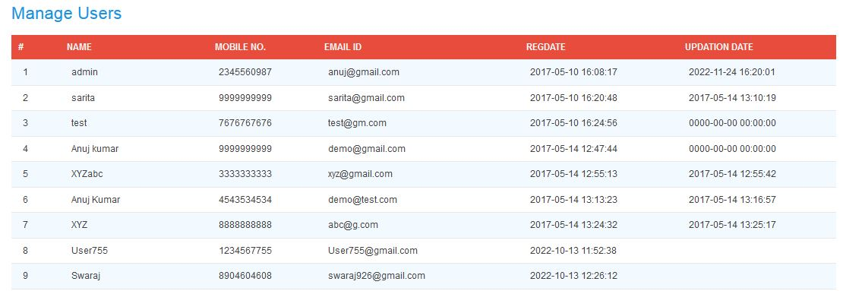
Project Modules
Explanation: Admin Module
Manage User:

Slide 9
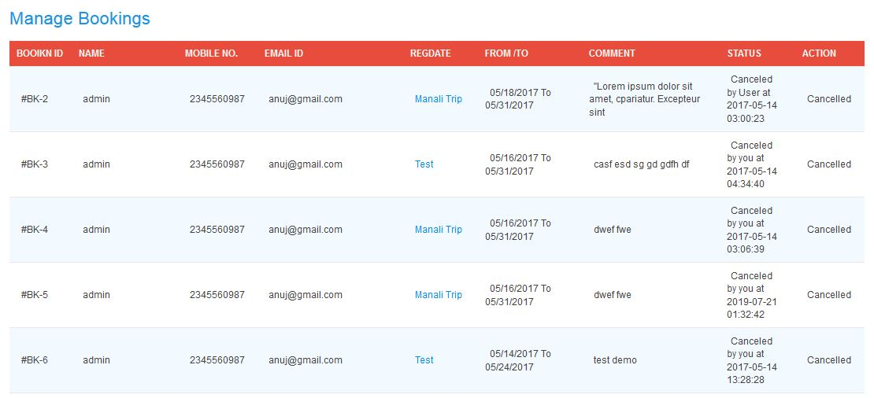
Project Modules
Explanation: Admin Module
Manage Booking: ( Confirm/Cancel)

Slide 10
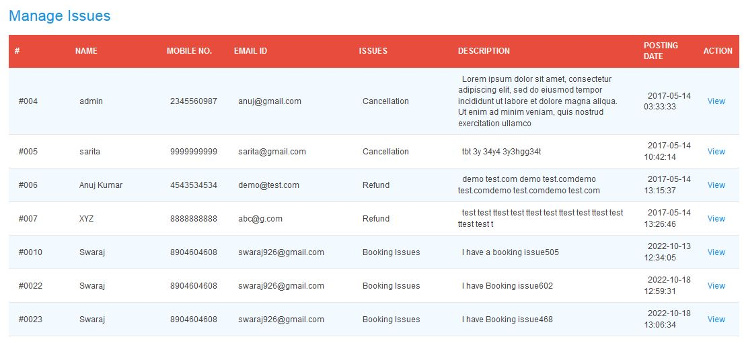
Project Modules
Explanation: Admin Module
Manage Issues:( View/Remark)

Slide 11
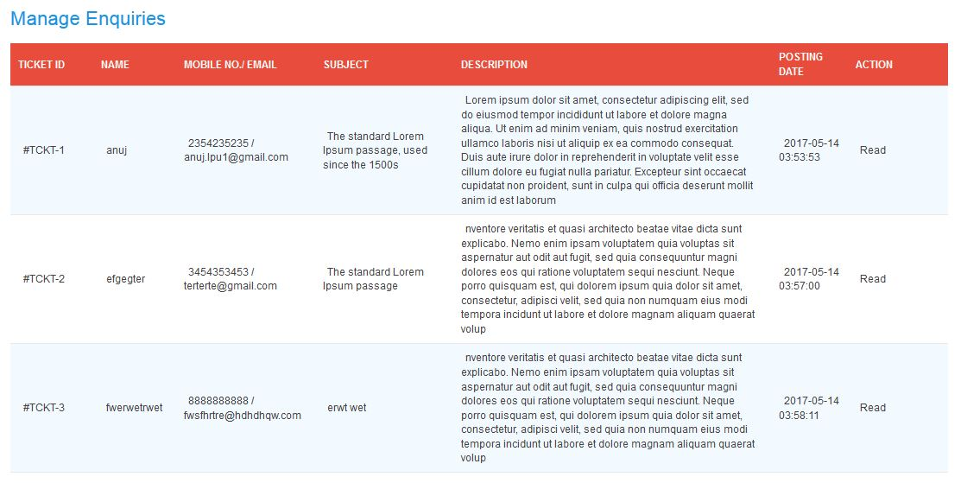
Project Modules
Explanation: Admin Module
Manage Enquiries:( Pending/Read)

Slide 12
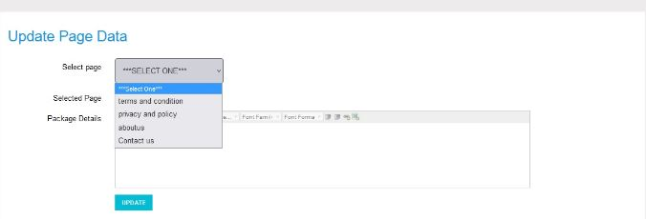
Project Modules
Explanation: Admin Module
Manage Pages:

Slide 13
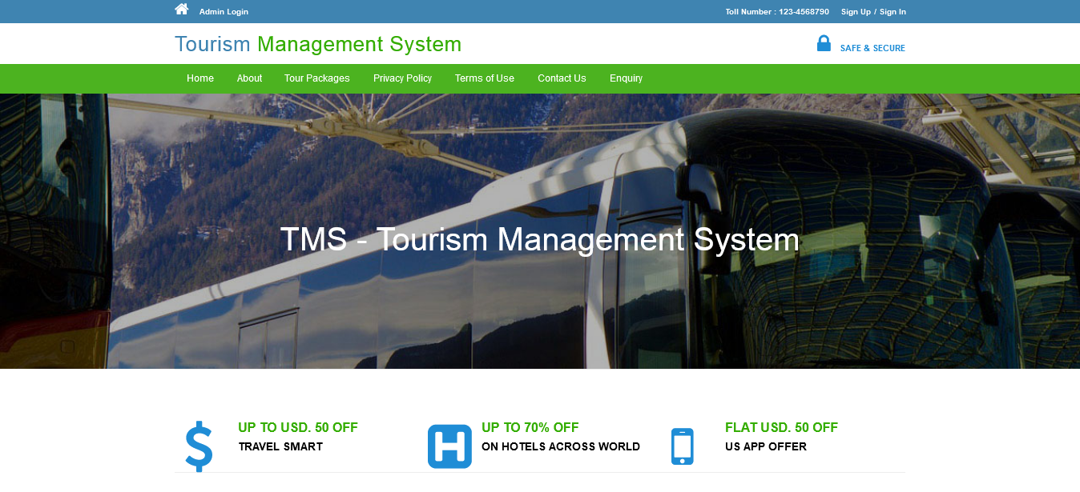
Project Modules
Explanation: Customer Module
Without SignIn:

Slide 14
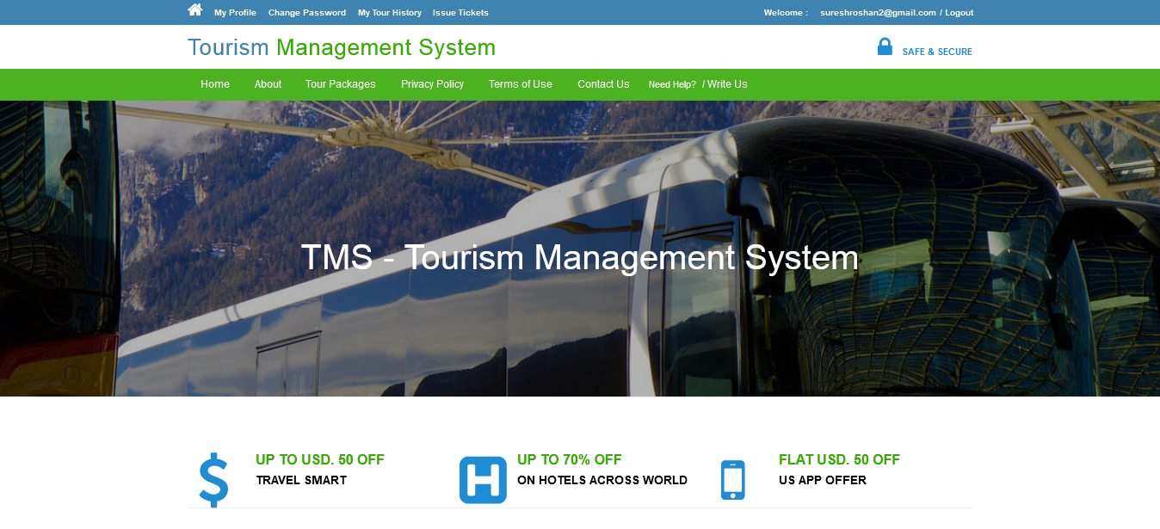
Project Modules
Explanation: Customer Module
With SignIn:

Slide 15
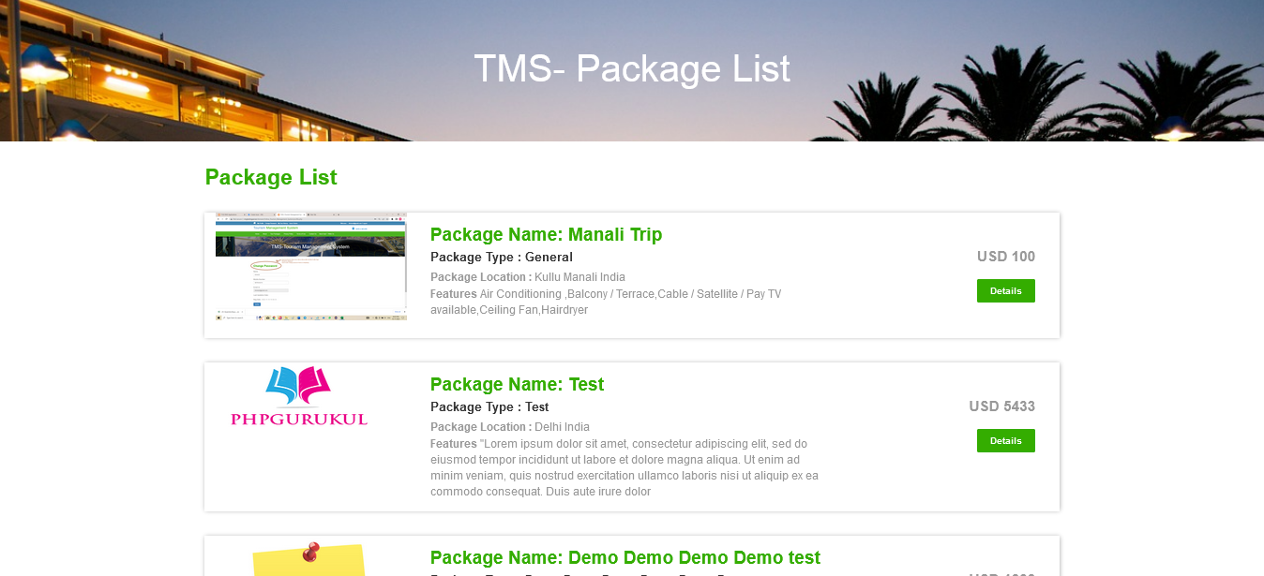
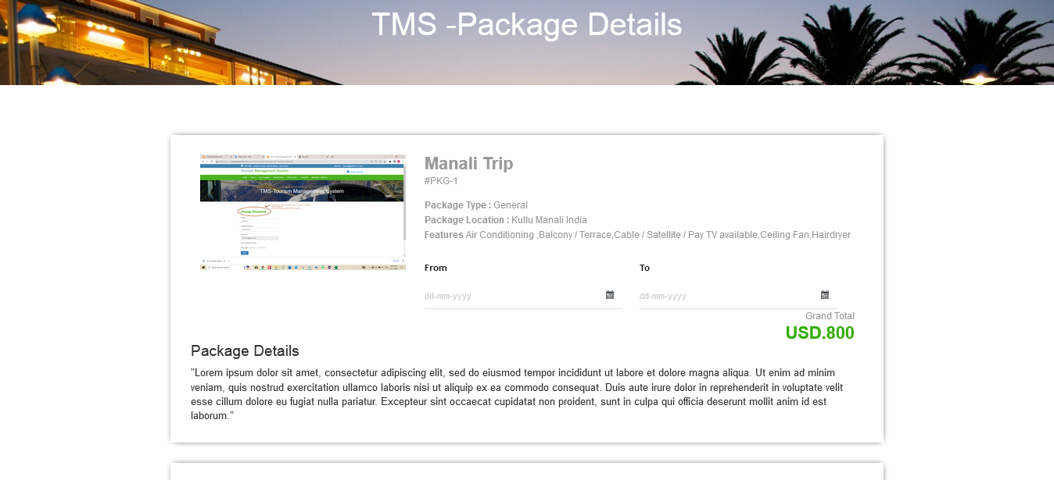
Project Modules
Explanation: Customer Module
Ticket Booking:

Slide 16
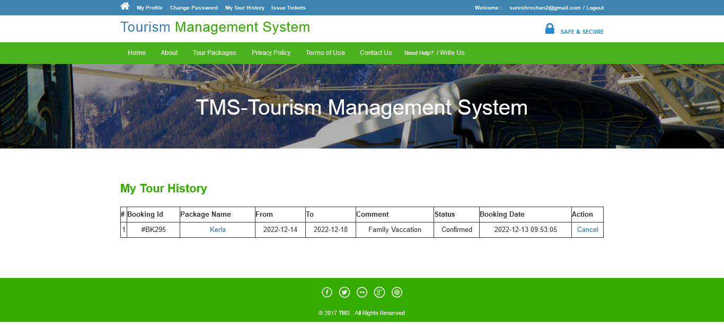
Project Modules
Explanation: Customer Module
My Tour History:

Slide 17
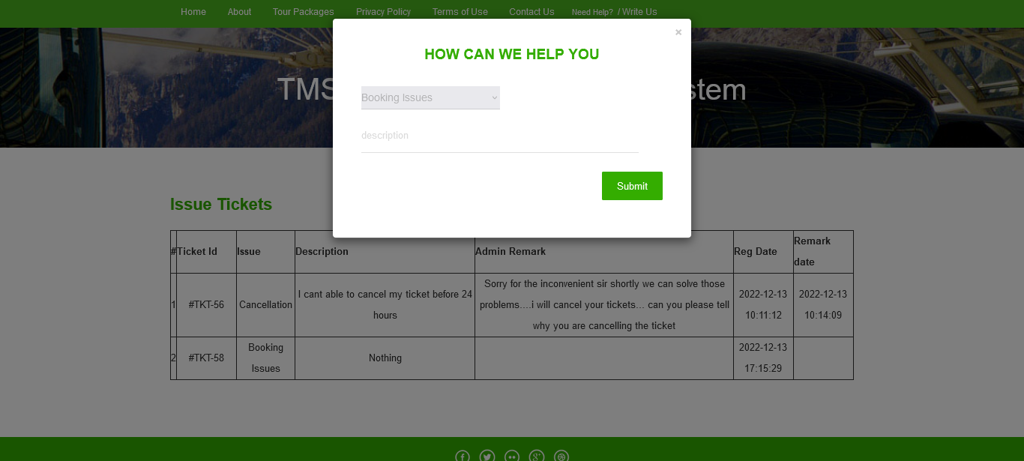
Project Modules
Explanation: Customer Module
Write US:

Slide 18
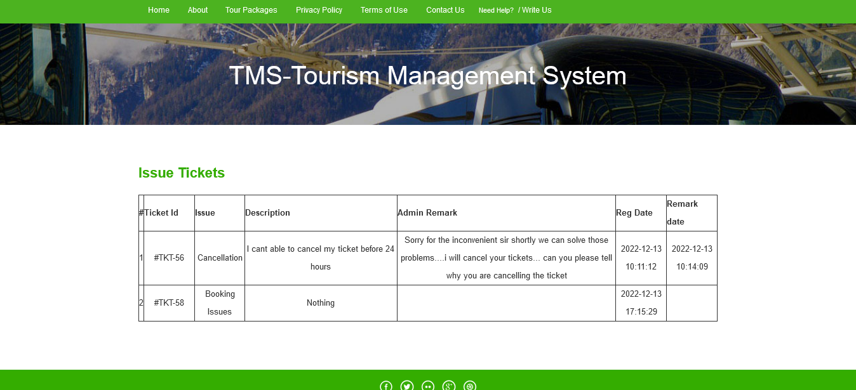
Project Modules
Explanation: Customer Module
Issue Tickets:

Slide 19
Project business few workflow
Admin Module Data flows:
Here data flows from Create to Tour Package and Manage to Tour Package
Data flows from Admin Tour Package to Customer Tour Package
In Manage Booking if Admin clicks the confirm/cancel data flows from Admin module Customer Module My Tour History
Manage Pages Data flows from Manage Page to Customer Module Pages

Slide 20
Project business few workflow
Customer Module Data flows:
Data flows from Tour Package to My Tour History
Data flows from Customer Module to Admin Module Manage Booking
Data flows from WriteUs to Issue Tickets
Data flows from Customer Module to Admin Module Manage Issues
My profile to Admin Module Manage Users

Slide 21
Effort & estimation

